Slide 1
Outer Stave Prototype Update
E. Anderssen, M. Cepeda, M. Garcia-Sciveres, M. Gilchriese, N. Hartman, J. Silber
LBNL
W. Miller, W. Shih
Allcomp, Inc
ATLAS Upgrade Week
April 2010

Slide 2
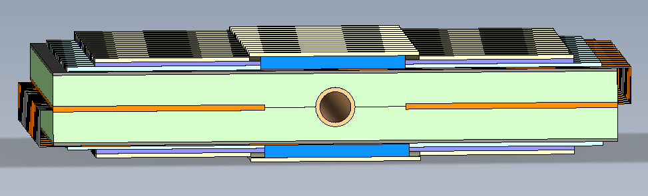
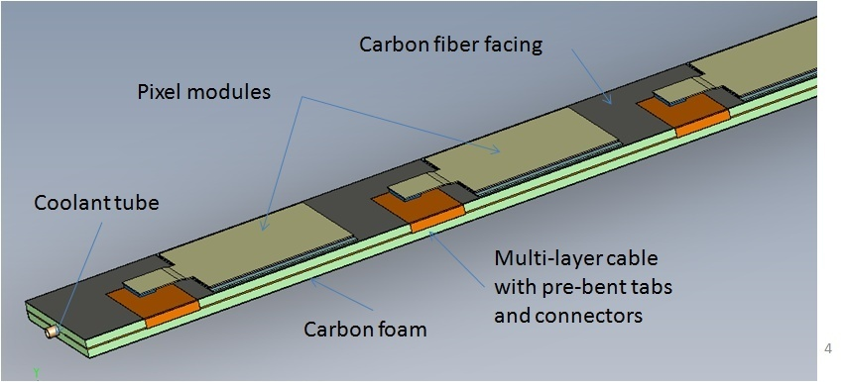
Basic Concept
Must have foam here
Foam 4.8mm thick
Cable ∼ 0.5mm
In slot in foam
Cable width restricted
K13D2U 0-90-0
∼ 0.25mm thick
∼ 4cm
SS or Ti 2-3mm OD
Note there are
4 separate cables
per stave
ρ ∼ 0.2, K ∼ 40 W/m-K

Slide 3
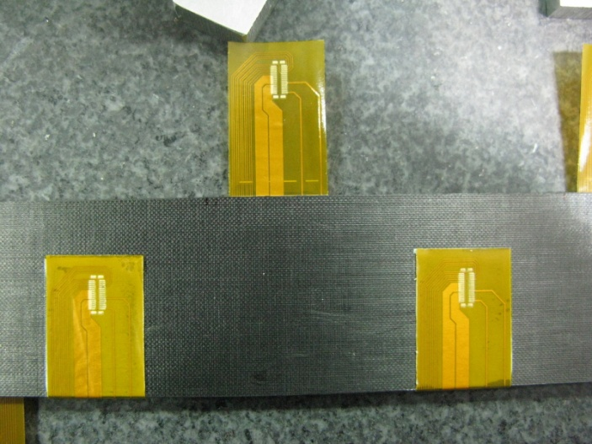
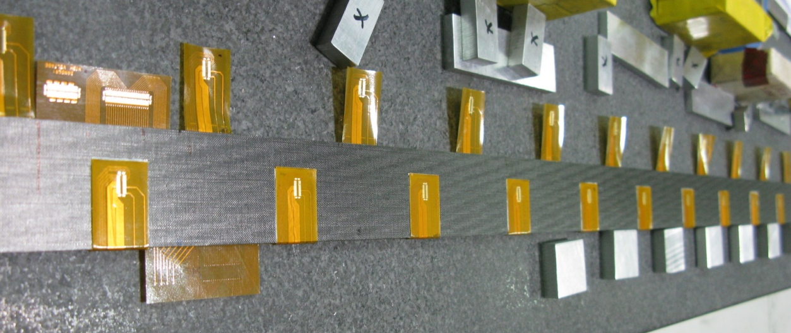
Use old 1m stave(K7 foam) made by Allcomp, Inc
Cables designed for full length stave(1.3m) ie they are about ½ the 1.3m length.
Cut slot for cable (would not do this for real stave).
Glue in cable and cable pieces. Bend tabs and glue.
No connectors yet.
Mount dummy silicon heaters one side.
Water at 20C. IR image of heaters
Tabs
End of cable. To use full length in central part of this stave

Slide 4
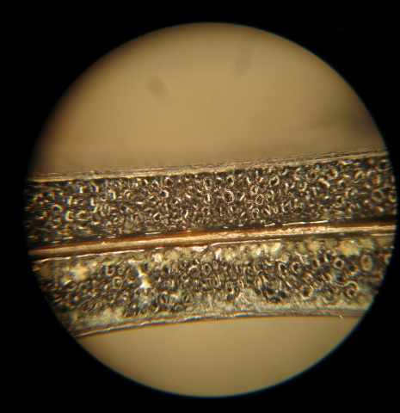
Thermal Results
Discovered delamination on part of stave
Lack of glue
Fabrication error(missed)
ΔT better than cable on top
As expected(for good region)
0.43 W/cm²
Embedded cable

Slide 5
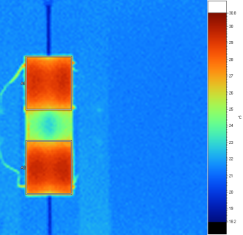
Short Prototypes
All about 12cm long. All of same basic construction.
Hysol 9396/BN(30% by weight) to bond tube to foam
And same for foam-to-foam, facings to foam
K7 foam – heaters both sides
One SS tube(2.8mm OD)
One Ti tube(2.2 mm OD)
Thermal cycle and irradiation(time sequence)
900 cycles (20C<->-35C) then
1 cycle to -70C then
1 cycle to about -175C with LN2 then
Irradiation to 50 MRad, then to 150 Mrad total
K7 foam – heaters on one side
One SS tube(2.8mm OD)
One Ti tube(2.2 mm OD)
Irradiation and thermal cycle(time sequence)
Removed one heater(and glue) after 1st thermal measurement
Irradiation to 1 GRad then
Put back removed heater
250 cycles (20<->-35)
K9 foam – heaters on one side
One SS tube(2.8 mm OD)
Thermal cycle only: 350 cycles(20<->-35)
IR measurements, water cooling at 1 liter/min at 20C
Power is 0.5 W/cm² on a heater
SE4445 used to mount dummy silicon heaters
Average temperature of dummy heaters will be shown

Slide 6
Summary of Results
No difference in SS and Ti tubes (with given ID/OD). Not a surprise (from FEA).
No significant change in thermal performance for any sample after any thermal cycle sequence, including LN2
Effect of irradiation up to 1 GRad is <10% increase in ΔT.
Thermal performance with K9 foam is significantly better than with K7 foam, by about 25%
Some details follow in next slides

Slide 7
Average temperatures
Error (over time) at least ±0.5C
No difference between Ti and SS
No change from thermal cycle
After 150 MRad, < 1C degradation(for 0.5 W/cm²)
Visual inspection of ends(tube exits foam) shows no damage
Good agreement(pre-rad) with simple FEA(shown many times before)
Ti tube 4 heaters(two sides)
SS tube 4 heaters(two sides)

Slide 8
Average temperatures
Error (over time) at least ±0.5C
No difference between Ti and SS
Top heater and glue removed before 1 GRad
Replaced after 1 GRad. Can’t see T vs B difference.
Change after 1 GRad small, again <1C(including error)
No change from thermal cycle
FEA (pre-rad) same as other K7, good agreement

Slide 9
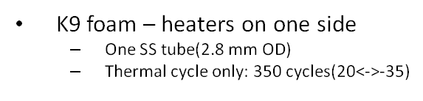
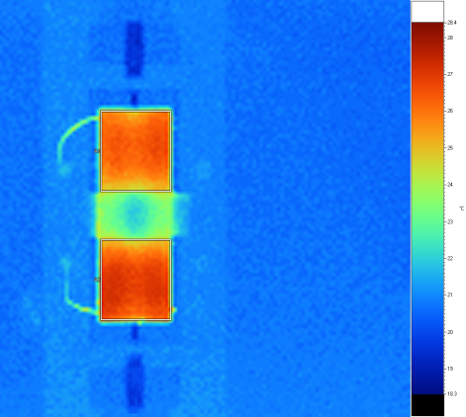
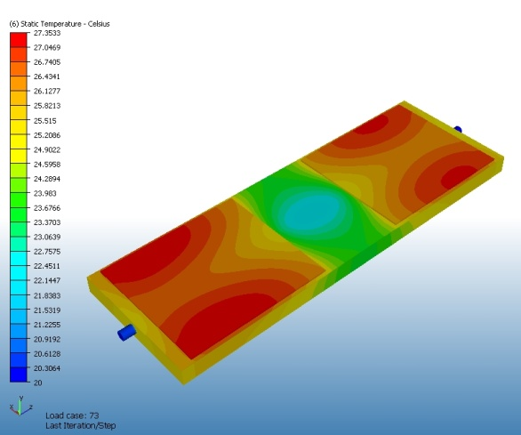
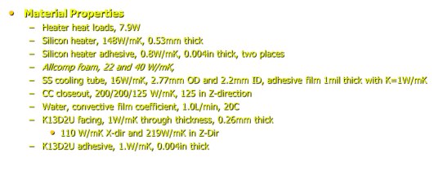
Average temperatures
Error (over time) at least ±0.5C
No change from thermal cycle
Results better than FEA prediction
FEA comparison of K=22(K7 foam) and K=40(K9 foam) predicts improvement of 1.3C in average temperature.
Measured is about 9C-7C=2C or more, ie. better.
Measurement errors? We think not
Why? No quantitative explanation.
130 ppi has smaller pore size => better contact with tube?
Simple bond line model between tube and foam is not correct
Glue penetration involves more high K ligaments?
Complicated FEA to get agreement
More prototypes needed
Will include also high K facings (heat treated)

Slide 10
Summary of Other Irradiation(1 GRad) Results
Hysol 9396 – shear strength measurements done improperly, no result. Thermal already described.
K7 foam
Limited sample size, remember spread in results(10%)
Tensile strength: before(195 psi); after(200 psi)
Compressive strength: before(195 psi); after (179 psi)
K9 foam samples not irradiated yet but don’t expect difference from K7 (but have to check)
K13D2U laminates
Few facing samples, thin, density varies by ± 8%
Modulus: before (44 Msi); after (44 Msi)
Strength: before (91 ksi); after (98 ksi)
Bottom line: OK to use unirradiated properties. Changes less than about 10%.

Slide 11
Support Studies
Presentation given to engineering group about 2 months ago
Have initial concept for support of complete SLHC pixel tracker: outer staves, disks and inner replaceable system
Shell support of outer staves with minimal rings
Inner pixels on rail system (not shown below)
Weights and load points estimated.
Preliminary FEA encouraging for relatively simple design.
Work on hold pending understanding of upgrade schedule and constraints

Slide 12
Next Steps
Other side of 1m stave looks OK, move heaters to this side…then
Electrical tests of cable inside 1m stave…then
Some thermal cycling to investigate reliability of cable gluing. Could use CO2 at SLAC or other methods.
Decision to be taken about making full-length prototype with K9 foam.
Make ½ length active stave(s) (see session on “Pixel Stave 2010”)
Will use K9 foam. Tube type (Ti or SS) to be chosen.
Good cables
Mount chip modules and eventually real modules
Plan for mechanical R&D depends some on outcome from this meeting
Will do under any circumstances
Continue prototype studies related to detailed understanding of foam, foam/glue and other stave interfaces both thermally and mechanically
Small prototypes with K9, including irradiation to 1 GRad (can take other’s samples again)
Construction of next long staves depends on overall design goal
“Early” replacement of pixel system: current design may not be optimal
Would like to prototype “bent” staves (to eliminate or reduce size of disks) – see talk in other session

