Slide 1
DUSEL Status
Proposal for a
Deep Underground Science and Engineering Laboratory
M. G. D. Gilchriese
University of California, Berkeley
LNGS
November 17, 2010

Slide 2
Topics
Location and background
Sanford Laboratory and DUSEL
Science goals
Current and near-future activities at Sanford Laboratory
Overview of the proposed DUSEL facility
Potential experiments
Planning
Very much a high-level summary!

Slide 3
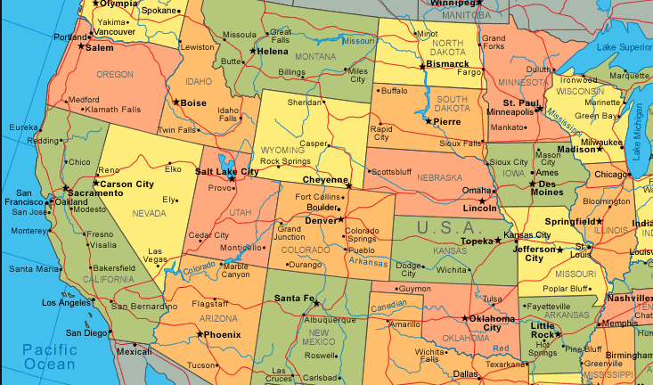
Location and Overview
Sanford Lab
DUSEL at Homestake
Fermilab
UC Berkeley
Sanford Underground Laboratory (Lead, South Dakota)
  Existing laboratory supported by the State of South Dakota and private sources at the former Homestake gold mine
DUSEL proposed for the Homestake site
  Proposal, led by UC Berkeley and Universities in South Dakota, will go to US National Science Foundation,

Slide 4
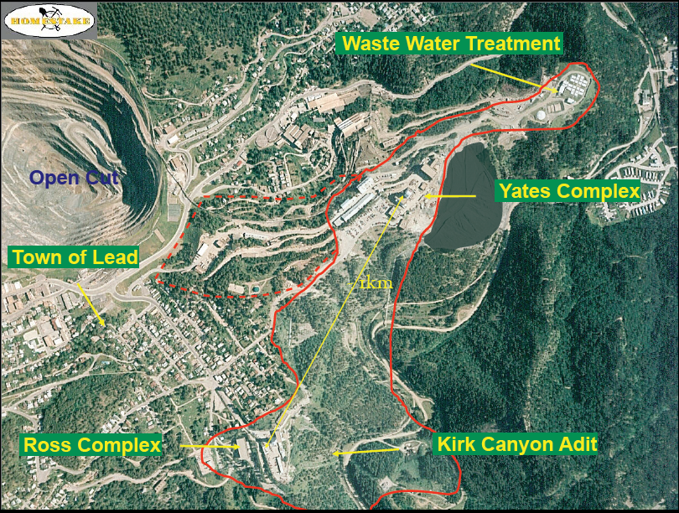

Slide 5
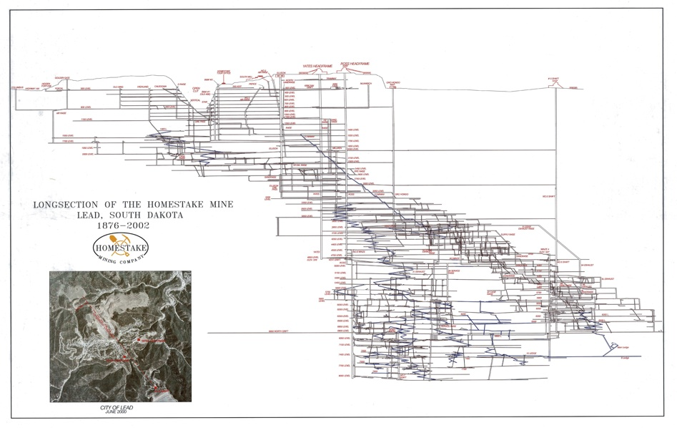
Homestake Cross Section
Yates
Ross
Oro Hondo
800L
4850L
#6 Winze
7400L
Notes:
Introduce the Facility corridor, and some nomadic
126 years of mining 600 km of drifts, multiple shafts,
trained work force

Slide 6
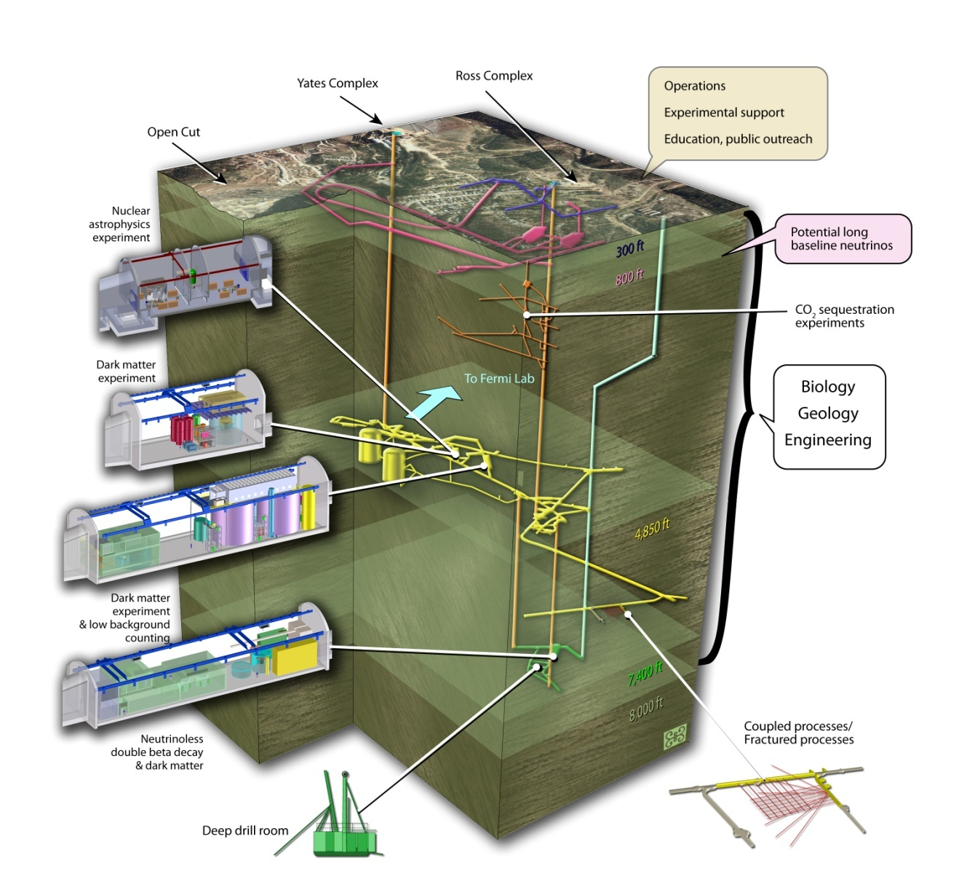
DUSEL Overview

Slide 7
Science Goals
Dark matter search/detection
0νββ decay
Long baseline neutrino oscillations
Proton decay
Supernovae and other neutrinos
Nuclear astrophysics
Enable low radioactivity studies and materials fabrication
R&D for the above
Other physics potential (underground gravity wave, etc)
Biology, geology and engineering(BGE)
Very broad program
Education and public outreach key aspect (not covered)

Slide 8
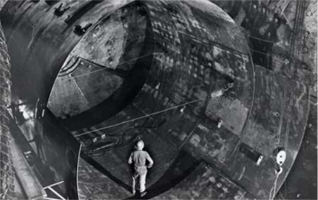
Sanford Underground Laboratory
Homestake was the site of the solar neutrino experiments by Ray Davis and collaborators.
Gold mining ceased in 2002
Water pumping stopped
The Homestake site was selected by the NSF in 2007 for design development of a DUSEL, after considering other US sites
The State of South Dakota and private individual (T. D. Sanford) initiated the rehabilitation of the Homestake site and formed the Sanford Underground Laboratory
Early experiments selected and initiated.
1965

Slide 9
Early Science at Sanford Lab
Early Science Research Groups
Physics
LUX-350 − Dark Matter
Majorana Demonstrator − 0νββ
CUBED − Crystal growth + other
Bkgd Characterization − μ,n,γ, Rn
(also Screening Lab in future)
Vertical Facility − N-Nbar, others
(currently magnetic field bkgd)
Geology CO₂ Sequestration − Environment
DUGL − Seismic characterization
Fiber Sensors − Extensometer, Temp
Hydrology − SDSMT/Sanford/DUSEL
Hydro-Gravity − USGS (SD,AZ)
PODS − Petrology, ore dep, structure
Tiltmeter − Rock deformation
Transparent Earth − Seismic
Biology Microbiology − Bang, Anderson
Lignocellulose − Bleakley
Manifold Sampling − Onstott, Pfiffner
Microbiology/Cellulose − Sani
Engineering
Signal Propagation − Anagnostou
Submersible − McGough
Other Cummingtonite − Geology (Berman)
(Site Vertical Array − Geology (Dahlgren)
Selection THMCB − Geology (DUSEL S4)
Only) Fracture Group − Geology (DUSEL S4)
EcoHydro Group − Geology (DUSEL S4)
Total Active = ~19 groups
(Plus Others)
Notes:
- PODS = Petrology, Ore Deposits, Structure

Slide 10
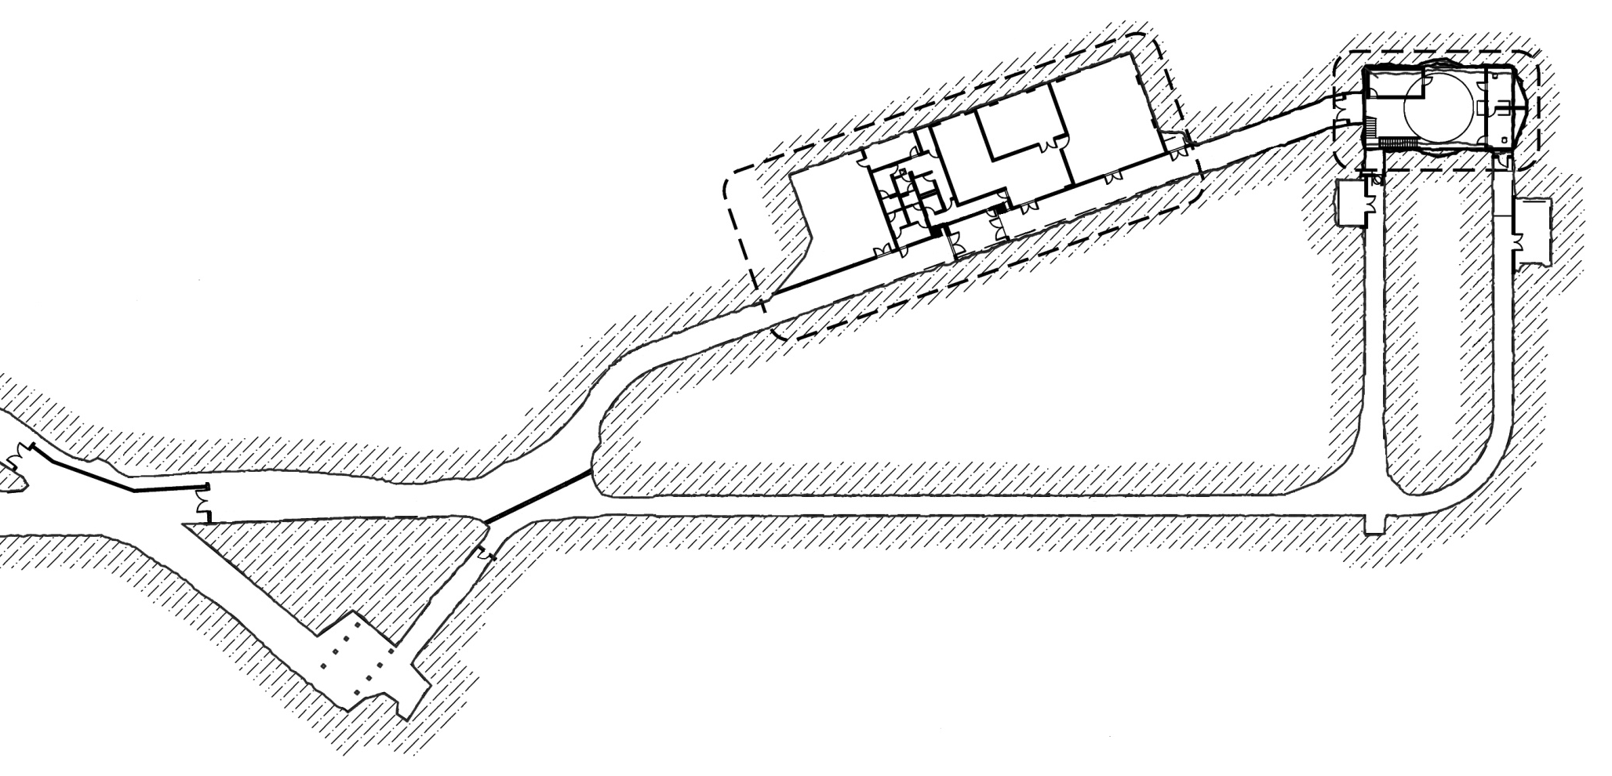
Sanford Laboratory Infrastructure
4850L Davis Campus: 745 m² (Total) / 455 m² (Science)
LUX Lab/Davis Cavern
(17mx9mx10m)
Majorana Lab/Transition
(41mx15mx5m)
New Access Tunnel
(~100 m to Davis Cavern)
Water
Purification
Ross Shaft
(~1000 m)
Cryogen Storage
Yates Shaft
Excavation nearly complete. Outfiiting, make into lab by ∼ October 2011
Electroforming for MAJORANA Demonstrator starts near Ross Shaft this year
Notes:
-> 745 m^2 = 8014 sq.ft, 455 m^2 = 4879 sq.ft
- transition space = 135’ x 50’ x ~10.5’, volume = 70,875 ft^3 (footprint = 6750 ft^2)
-> Davis Cavern = 55’x30’x32’ (original dimensions), volume = ~52,800 ft^3 (footprint = 1650 ft^2)
-> volume ratio = ~1.3 (ie., new transition cavern 30% larger volume than existing Davis)
-> footprint area ratio = 4

Slide 11
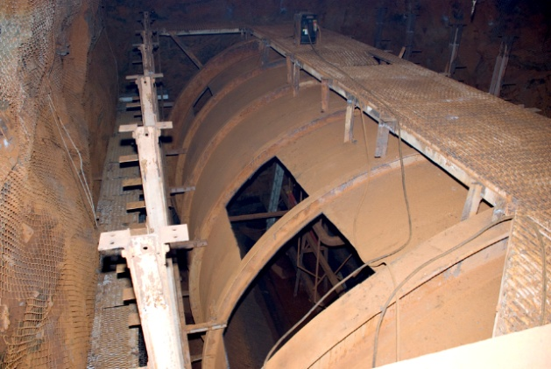
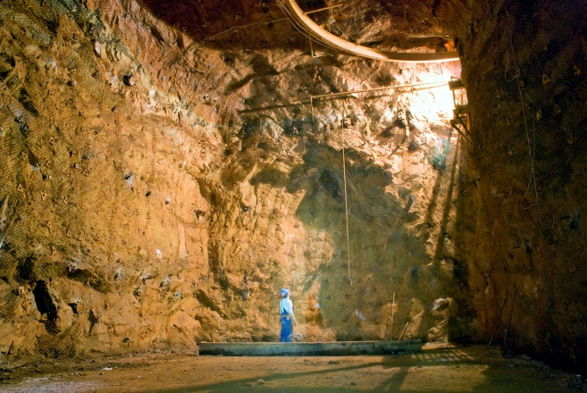
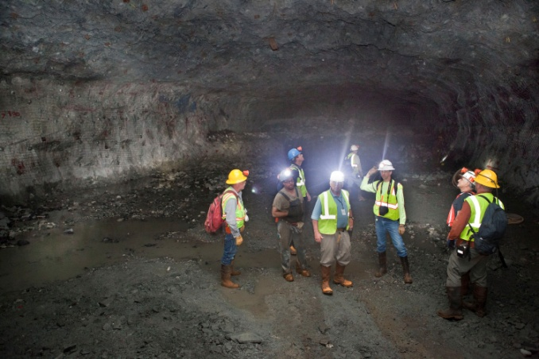

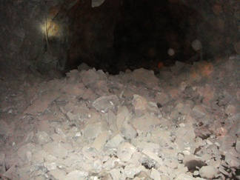
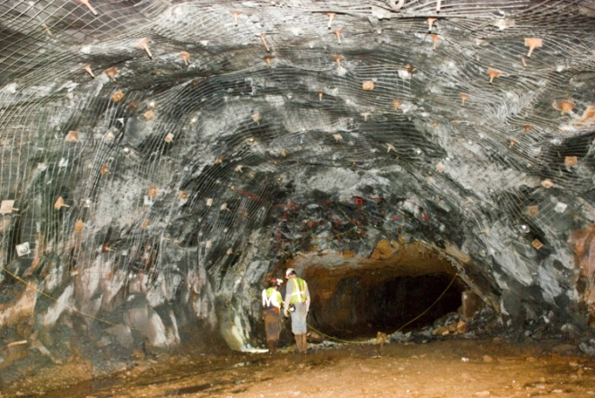
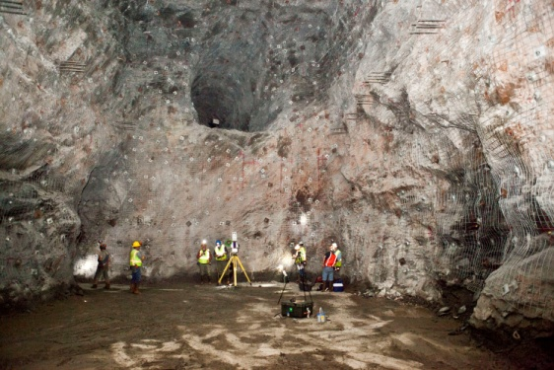
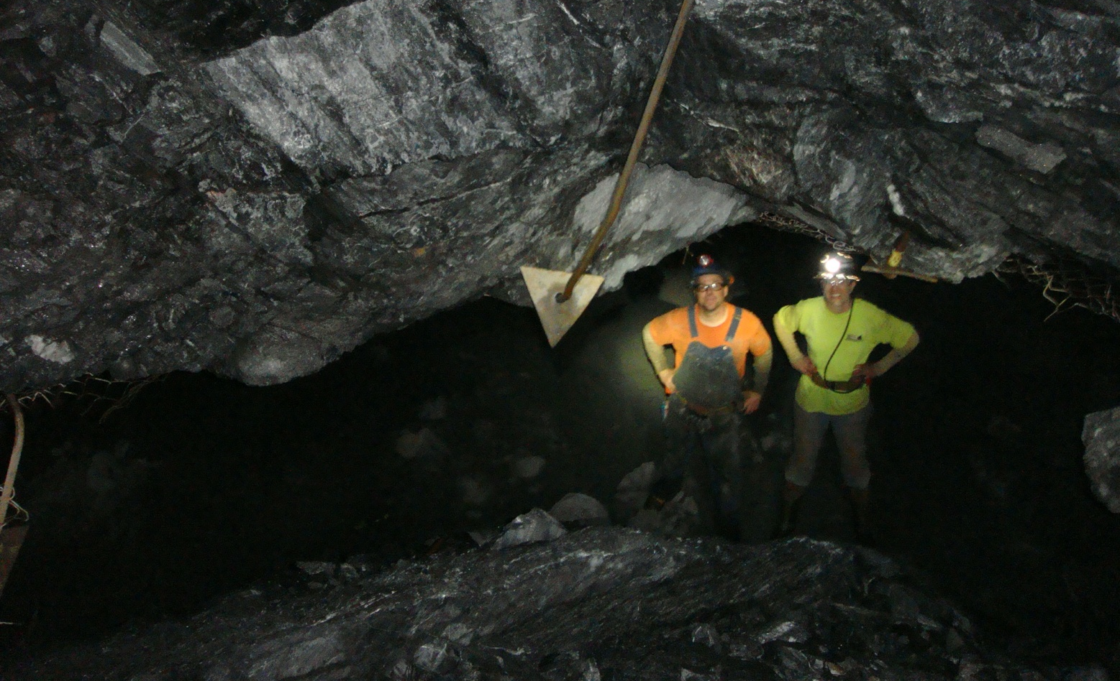
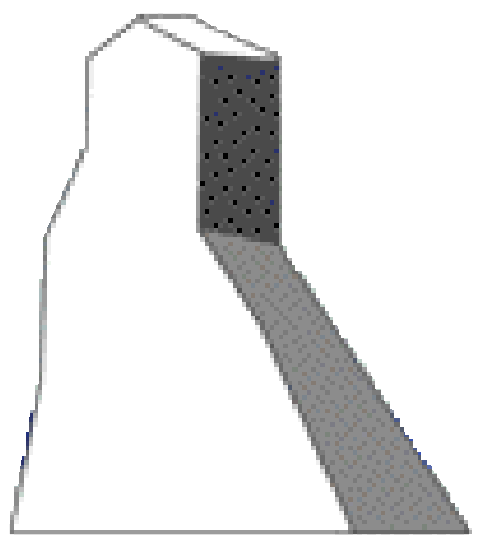
Sanford Laboratory Infrastructure
4850L Davis Campus Development:
Aug 09: Davis Tank
Removal Begins
Sep 09: Davis Tank
Removed
Aug 10: Majorana/
Transition
1
2
7
Sep 09: 1st Blast
3
Oct 09: Yates Xsect
Aug 10: Davis Cavern
Feb 10: Breakthrough
4
5
6
Notes:
-> 745 m^2 = 8014 sq.ft, 455 m^2 = 4879 sq.ft
- transition space = 135’ x 50’ x ~10.5’, volume = 70,875 ft^3 (footprint = 6750 ft^2)
-> Davis Cavern = 55’x30’x32’ (original dimensions), volume = ~52,800 ft^3 (footprint = 1650 ft^2)
-> volume ratio = ~1.3 (ie., new transition cavern 30% larger volume than existing Davis)
-> footprint area ratio = 4

Slide 12
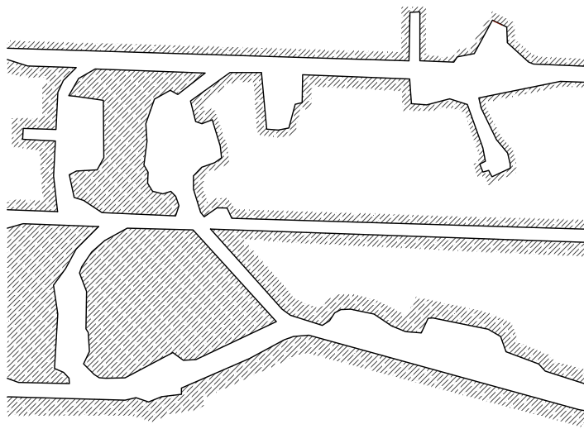
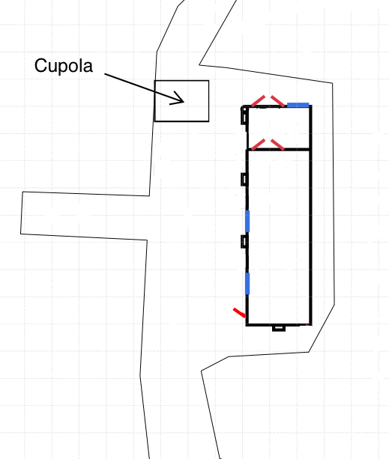
Sanford Laboratory Infrastructure
4850L Ross Temporary Laboratory
~60 m
Davis Campus
(~1000 m)
Ross
Shaft
Electrical
Station
(Temp)
11 m
16 m
#6 Winze
Notes:
- Majorana cleanroom = 12’ wide x 40’ long

Slide 13
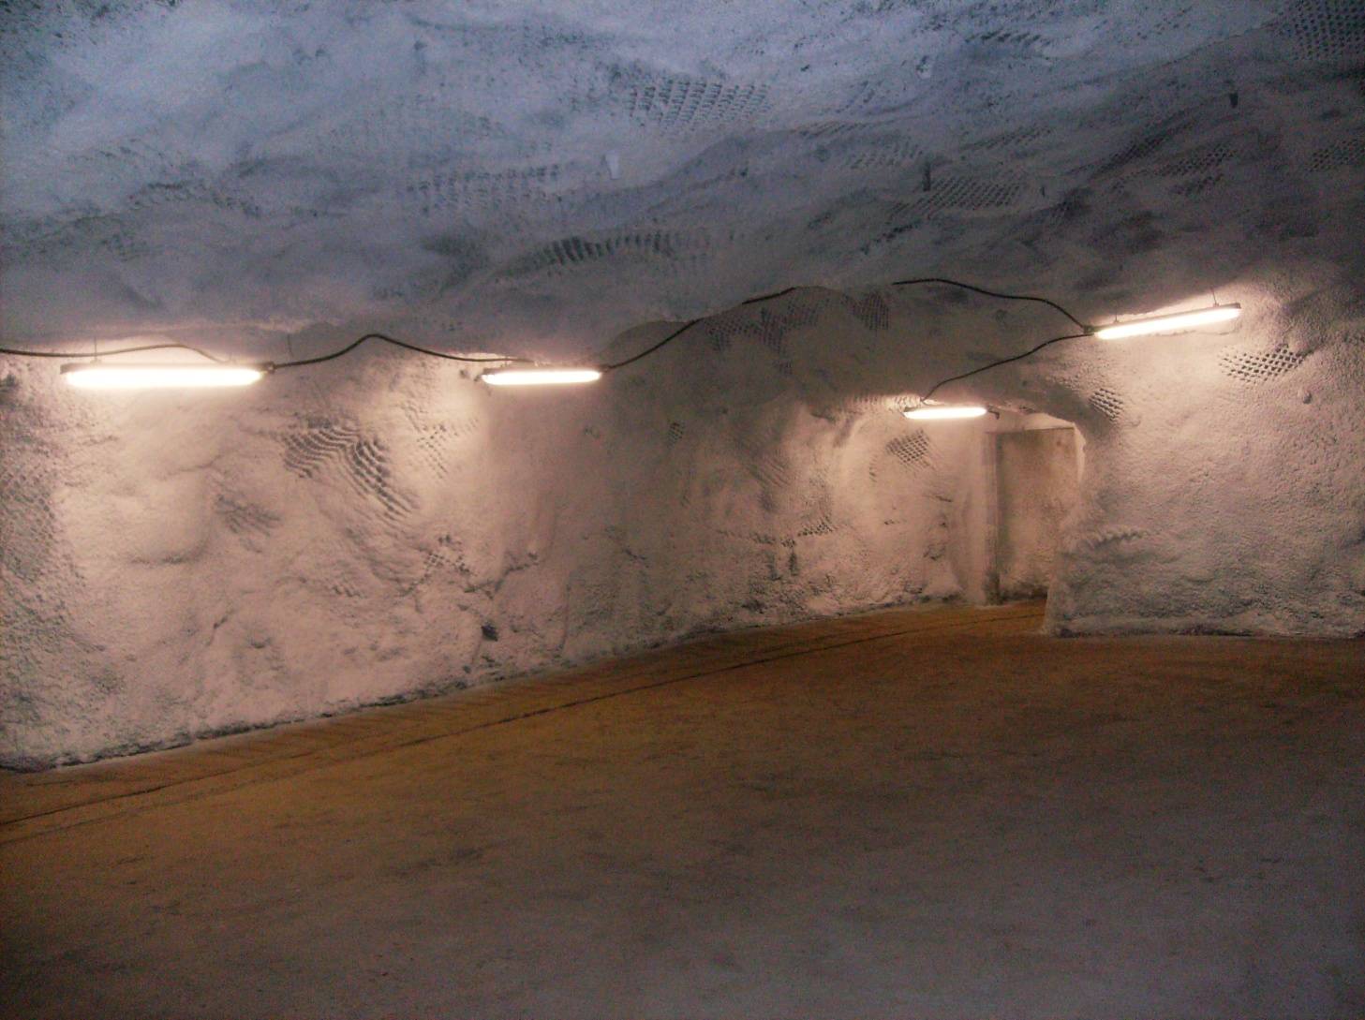
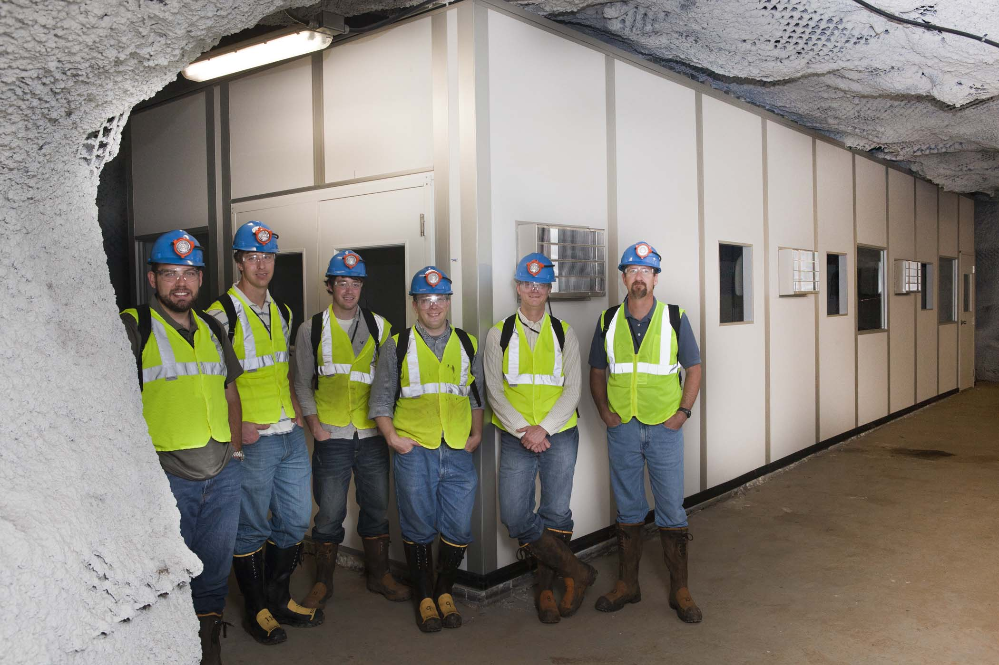
Temporary (few years) Infrastructure
4850L Majorana Electroforming Lab
Sep 2010
Clean room nearly complete
Oct 2010
Notes:
- pictures taken September 2010

Slide 14
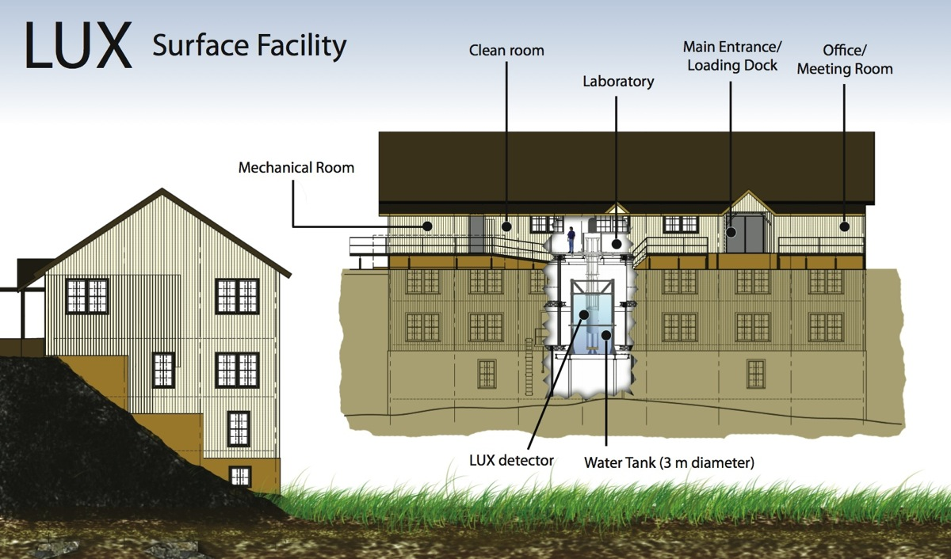
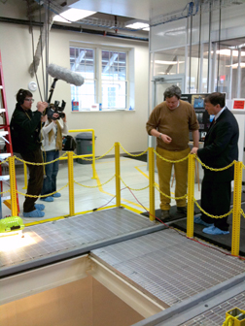
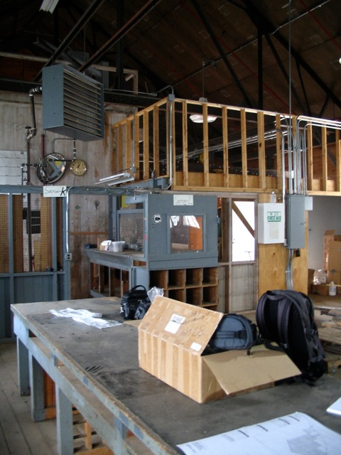
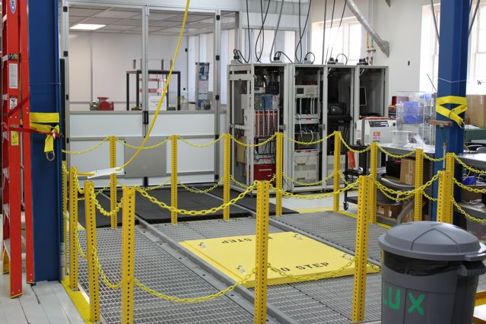
Surface Laboratory
Surface Laboratory: 190 m² Lab Space
Sep 2008
May 2010
Dec 2009
Notes:
- finished lab space = 2,040 sq.ft

Slide 15
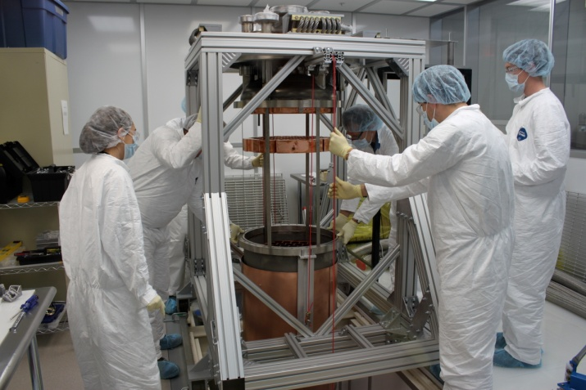
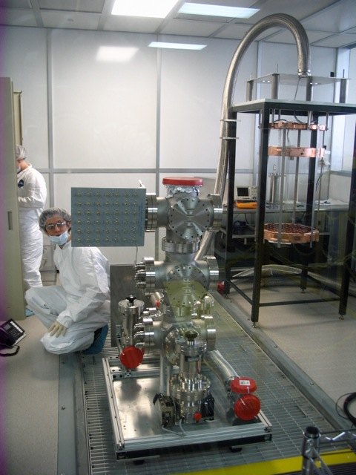
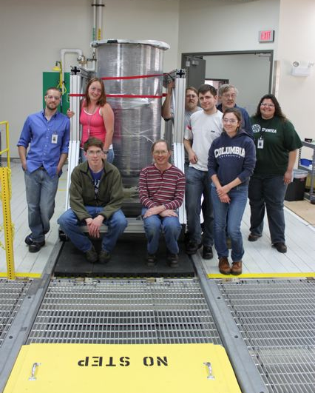
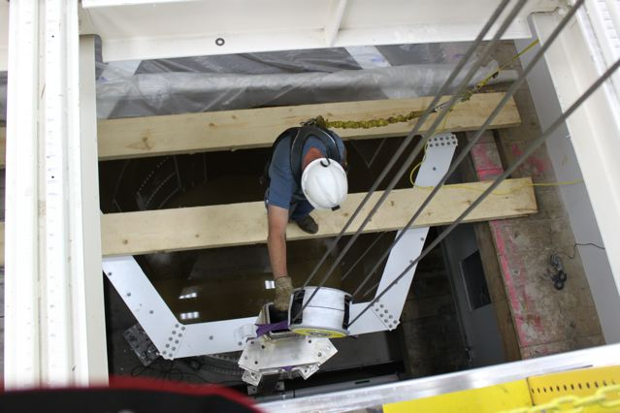
Initial Science: Physics
Large Underground Xenon (LUX-350)
Jun 2010
Project:
  Direct search for dark matter using 350 kg of xenon
  Occupy Surface Laboratory to exercise procedures, test installation and detector operation
  Small water tank to allow operation (larger one UG)
Collaboration:
  ~52 researchers (incl students)
  14 institutions + Sanford Lab
Milestones:
  Sep 09: Grad students onsite
  Dec 09: Surface Lab activity starts
  Winter 10 ->: Surface detector ops
  Fall/Winter 11: Davis Campus
May 2010
Jun 2010
Jul 2010

Slide 16
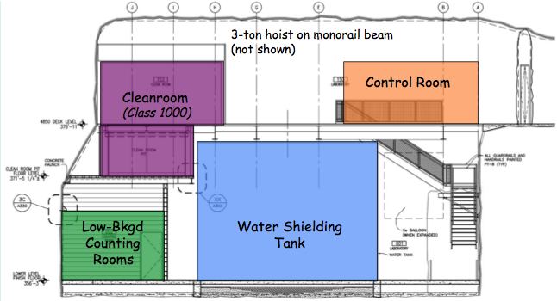
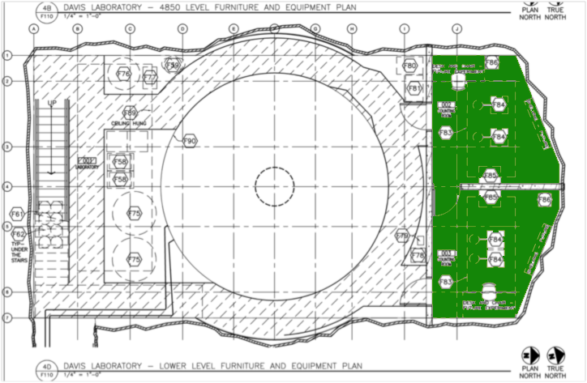
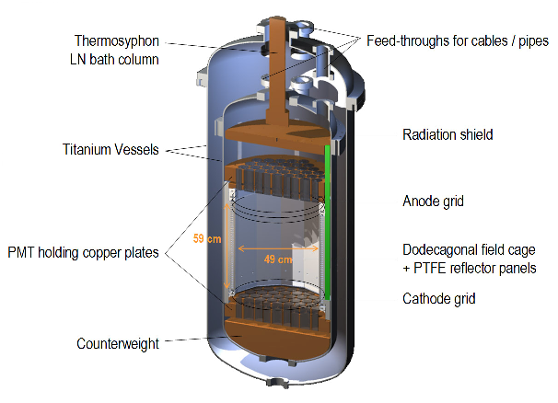
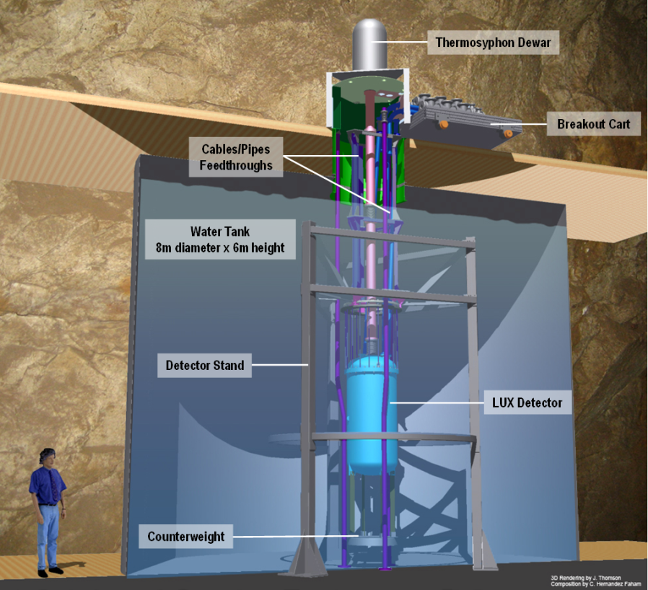
LUX in Davis Campus

Slide 17
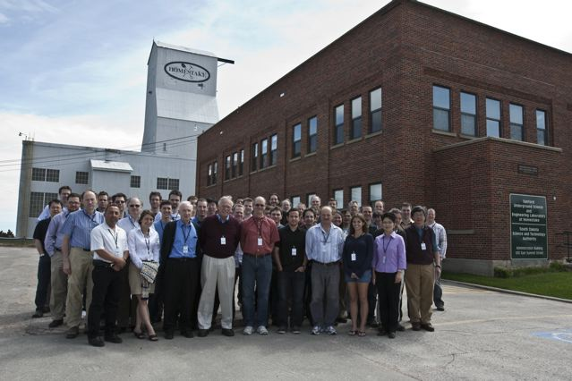
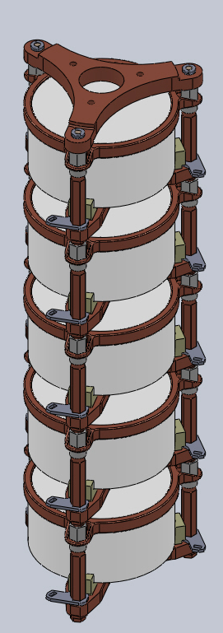
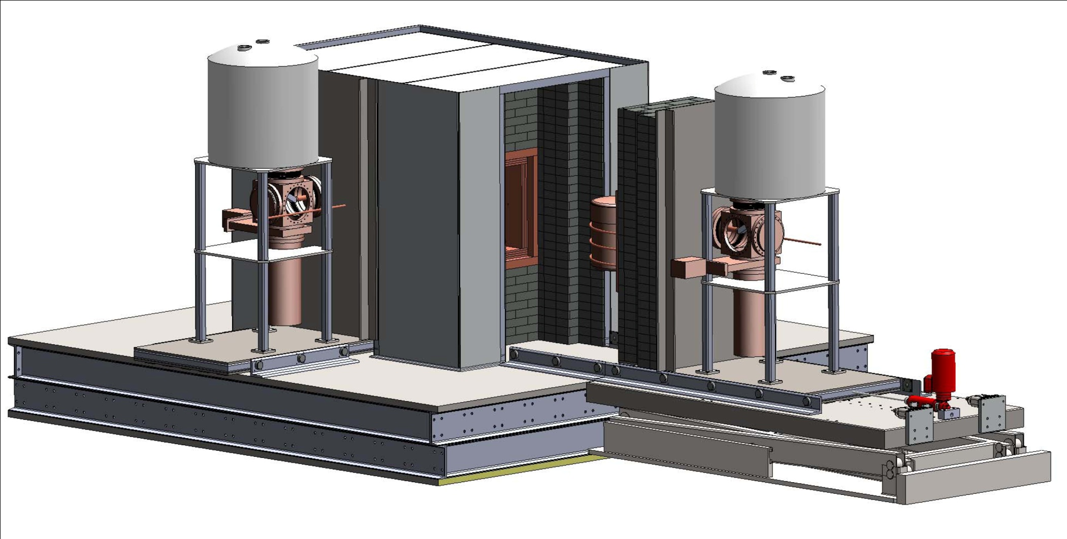
Initial Science: Physics
Majorana Demonstrator
Jun 2010
Project:
  Investigate neutrinoless double beta decay using 40 kg Ge (some natural, some enriched ⁷⁶Ge)
  Demonstrating technology for 1- tonne detector (requires < 1 bkgd count per year near signal region!)
  Electroform copper for shielding and detector components
Collaboration:
  ~93 researchers (incl students)
  18 institutions + Sanford Lab
Milestones:
  Jun/Aug 09: Pb, Cu onsite
  Dec 09: Temp lab work begins
  Winter 10: Occupy TCR, e-form
  Fall/Winter 11: Davis Campus
Notes:
-> DOE R&D funding, becoming DOE project asking for $20.2M

Slide 18
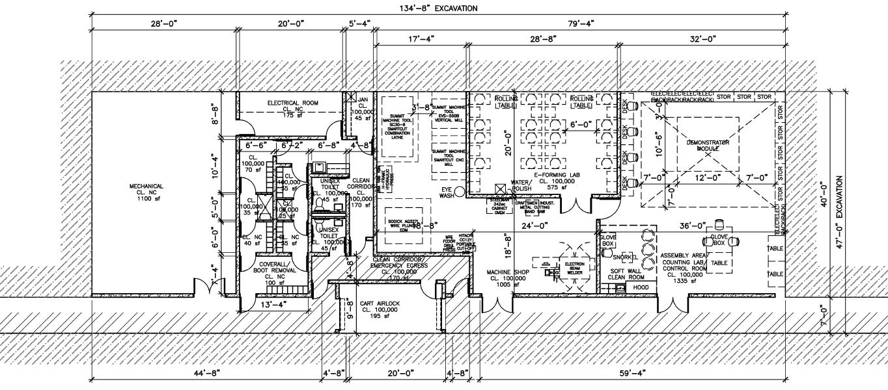
Early Science: Physics
4850L Davis Campus: Majorana Lab + Transition
Mechanical/Electrical/Air
Machine Shop
Electroforming
Detector
Yates
Shaft
Personnel
Transition
Material
Transition
Cleanroom
(Class 100)
Davis Cavern

Slide 19
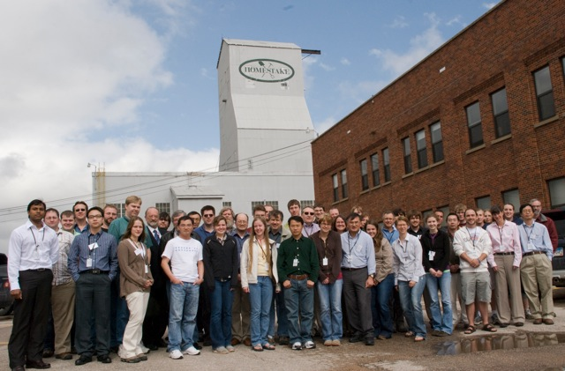
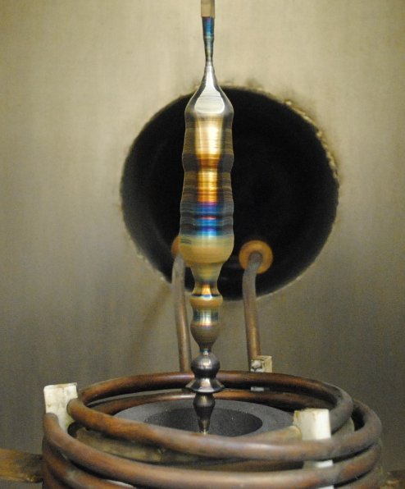
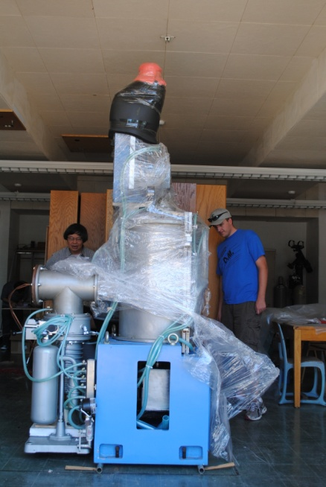
Initial Science: Physics
Center for Ultra-low Background Expts at DUSEL (CUBED)
Project:
  South Dakota Governor’s Research Center ($3M funded 2009-2014)
  Manufacture high-purity crystals (Ge; possibly NaI, CdWO₄)
  Activities include crystal growth, zone refining and detector development
  $3M from DOE EPSCoR (3 yrs)
Collaboration:
  ~54 researchers (incl students)
  7 institutions + advisors
Milestones:
  May 09,10: Collab meeting at Lab
  Jun 10: Xstal pullers, Ge at USD
  Next 2 yrs: Surface labs
  Summer 12: Underground lab
May 2010
Sep 2010
Jul 2010
Notes:
-> SD Research Center part of Governor Rounds 2010 Initiative, $3M over 5 years
-> technical approval for DOE EPSCoR = $3M over 3 years
-> 30 kg Ge at USD, ~15 kg Ge at SDSMT

Slide 20
Initial Science at Sanford Lab
Initial Science Research Groups and Laboratory Footprint
Surface USD/BHSU − Gamma, Rn
Regis − Muon
SDSMT − Climate station
UT/BHSU − Mag field, Ross/Yates
USGS − Microgravity
300L DUGL − Low-freq seismometer
USD/BHSU − Rn
SDSMT − Signal propagation
BHSU − Biology baseline samples
800L DUGL − Low-freq seismometer
USD/BHSU − Gamma, Rn
Regis − Muon/neutron
LBNL − CO₂ sequestration
Majorana − Pb, Cu storage
PODS − Geology (pet,ore dep,struct)
1250L SDSMT − Climate station
USD/BHSU − Rn
1700L SDSU − Bio samples
2000L SDSMT/FNAL/UW − Water-level
tiltmeters (x3), climate
2000L SDSMT/UCB − Seismo/tilt (x2)
(cont) DUGL − Low-freq seismometer (x3)
USD/Regis − Gamma, Rn and
muon/neutron
BHSU − Seeps, fungus samples (x2)
LBNL − CO₂ sequestration
2600L SDSMT − Climate station (x2)
3350L Utah − Extensometers
4100L DUGL − Low-freq seismometer (x3)
UW/MT − Optical extensometers
SDSMT/UCB − Seismometers/tilt
BHSU, Many − Biology sampling
4550L USD − Gamma, Rn
Many − Bio samples pump water
4850L SDSMT − Hydrometry probes
LBNL − CO₂ sequestration (removed)
BHSU, Many − Biology samples
USD/BHSU − Rn
Many − Core holes (hydrology, bio)
Notes:
-- Over a dozen groups on a dozen levels
- Expansion likely on several levels (eg., 4850L, 5000L); also interest in 4100L, but need Yates shaft and some rehab
- PODS = Petrology, Ore Deposts, Structure

Slide 21
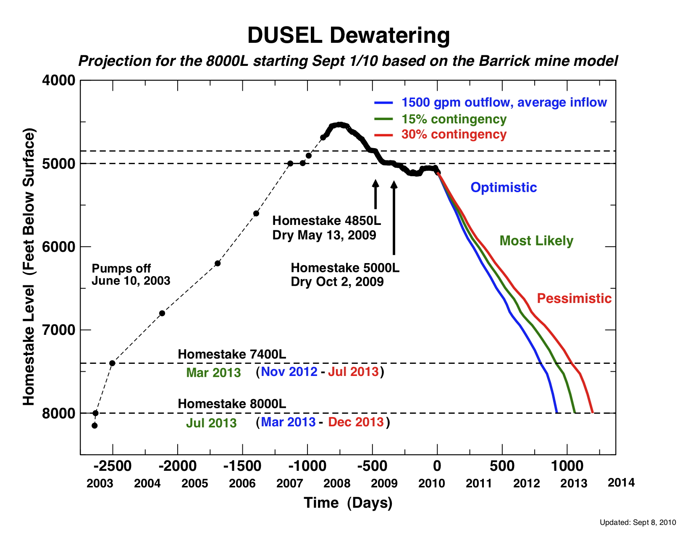
Dewatering

Slide 22
Science Goals <-> Sanford Lab/DUSEL
Dark matter program
  Generation 1 (G1) by LUX at Sanford Lab
  Potentially G2 at Sanford, started prior to DUSEL construction, finish in DUSEL era
  One or more G3 at DUSEL
0νββ decay
  MAJORANA Demonstrator at Sanford lab operates into DUSEL era
  One or more large, next generation experiments at DUSEL
Long baseline neutrinos, proton decay, other neutrinos
  Combined function detectors (water Cherenkov and/or liquid argon)
  (Anti)Neutrino beam from Fermilab (and near detector)
Nuclear astrophysics
  Potentially dedicated accelerator facility, decade(s) operation
Low background and materials manufacturing
  Basic capability proposed to be part of DUSEL capability
  Large facility, unique capabilities evaluated as part of overall scientific program
Enable R&D (dedicated space, although may evolve with time)
Other physics – evaluated as part of overall scientific program
Broad program in biology, geosciences and underground engineering

Slide 23
Biology, Geology & Engineering
What controls the distribution and evolution of subsurface life?
How deeply does life extend into the Earth?
How do fluid chemistry, rock mechanical properties, and microbes evolve in fractured crust under changing temperature, stress, and flow?
Research and development on basic processes relevant to CO₂ sequestration
Understanding the mechanical response of rock masses on length scales from cm to km and time scales from milliseconds to years
Advanced seismic and electromagnetic probes and monitoring, precision seismology
Advanced engineering design for large cavities and other underground construction and monitoring over many years, leading to advances in the design of underground cavities
Controlled fracture and fault experiments on significant scales

Slide 24
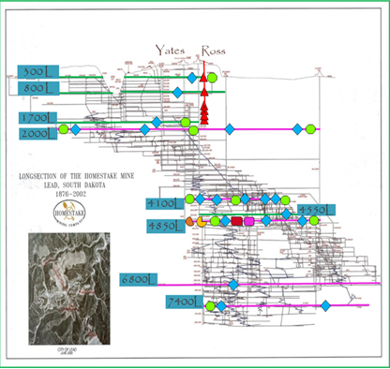
Biology, Geology & Engineering
Facility will provide significant but not unlimited access, ventilation, power, communications.
Multiple levels
Facility total
scope fixed for BGE
Experiment scope will
be adjusted to match
total funds available

Slide 25
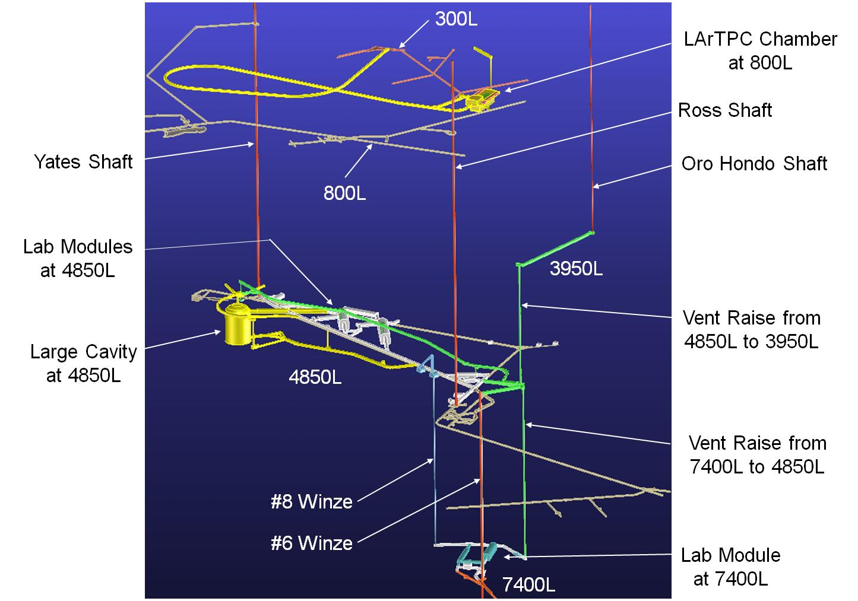
DUSEL Layout

Slide 26
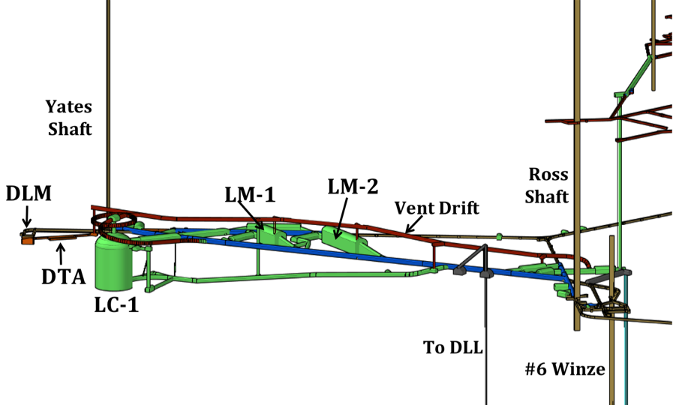
DUSEL 4850L

Slide 27
DUSEL 4850L – Plan View
Lab module1: (W)20mx(H)24mx(L)50m
Lab module 2:(W)20mx(H)24mx(L)100m

Slide 28
DUSEL 7400L
Lab module: 15mx15mx75m

Slide 29
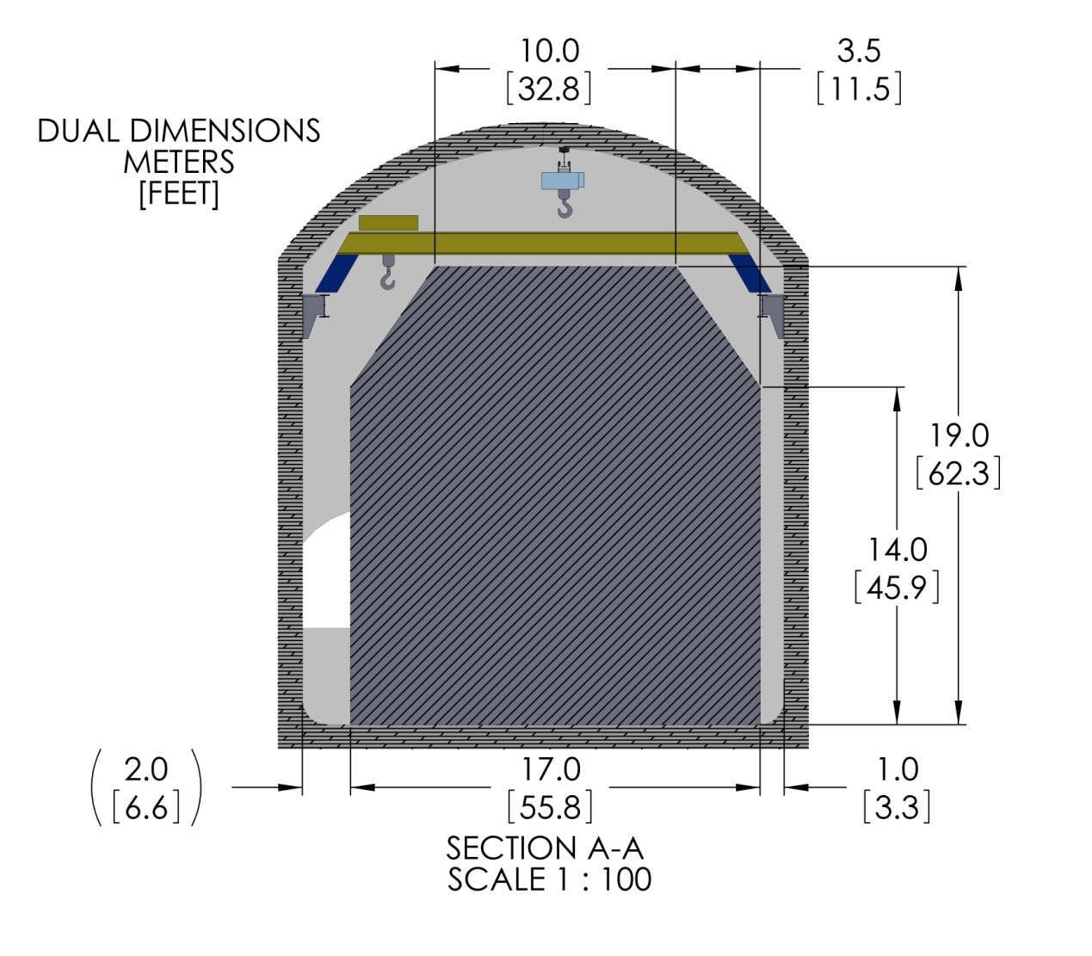
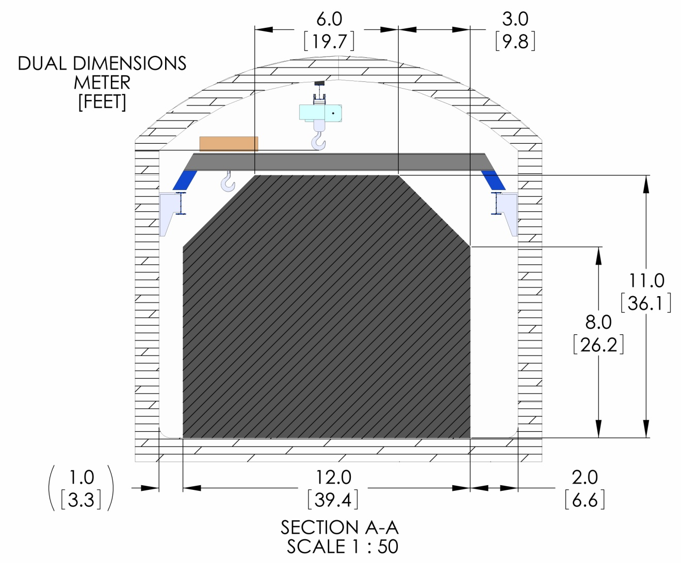
Nominal Experiment Space
MLL
DLL

Slide 30
Experiments ⬄ Facility Design
NSF program underway for more than a year to support design of and R&D for potential DUSEL experiments
LBNE project in addition
Principal source of input to facility design so far
Input welcome
Collaboration | Principal Investigator | Institution
Physics
Dark Matter
MAX | Galbiati | Princeton University
LZ20 | Shutt | Case Western Reserve University
GEODM | Golwala | Caltech
COUPP | Collar | University of Chicago
Neutrinoless Double Beta Decay
EXO | Gratta | Stanford University
GE1T | Wilkerson | University of North Carolina
Long Baseline Neutrinos and Proton Decay
LBNE Collaboration | Svoboda | University of California Davis
LBNE Project | Strait | Fermilab
Nuclear Astrophysics
DIANA | Wiescher | University of Notre Dame
Advanced Assay and Ultrapure Materials
FAARM | Cushman | University of Minnesota
Biology, Geology, and Engineering Experiments
Transparent Earth | Glaser | University of California, Berkeley
Fiber-Optic Array | Wang | University of Wisconsin
Fault Rupture | Germanovich | Georgia Tech
Coupled Processes (THMC) | Sonnenthal | University of California, Berkeley and LBNL
EcoHydrology | Boutt | University of Massachusetts
Excavation Monitoring | Bobet | Purdue University

Slide 31
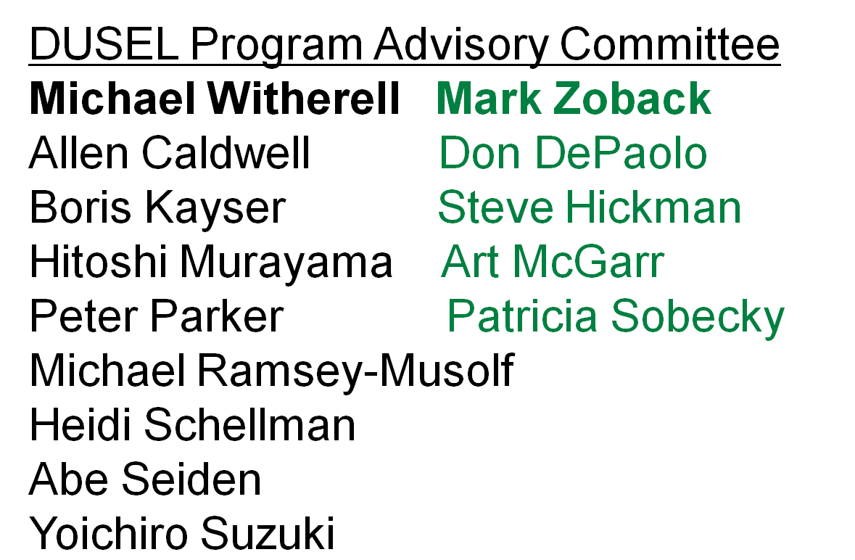
Program Advisory Committee
A DUSEL Program Advisory Committee has been formed.
Physics and BGE
Currently providing general review and advice
Would review specific experiments if project approved.

Slide 32
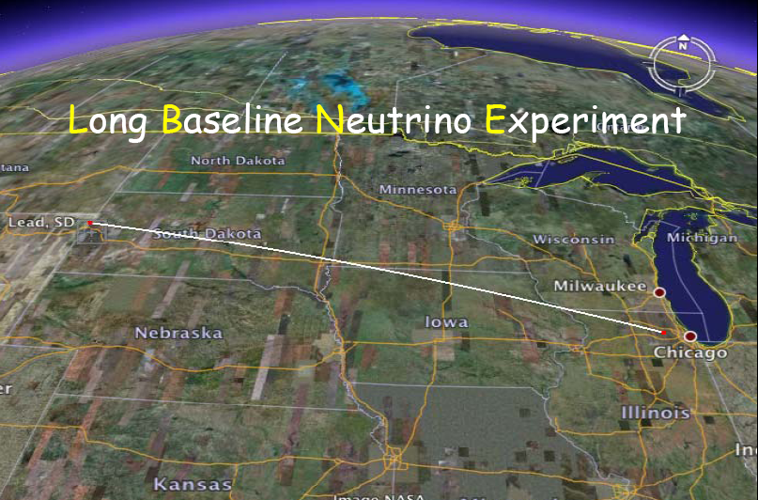
1300 km from FNAL to DUSEL
Neutrino beam from FNAL main injector
Near detector at FNAL
Rate in far detector peaks at few GeV

Slide 33
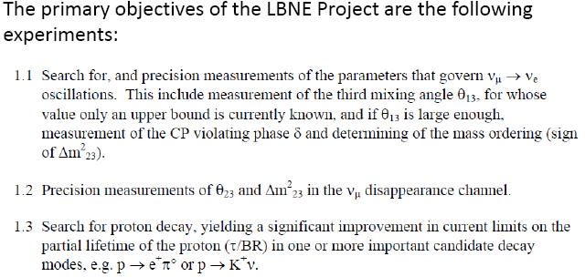
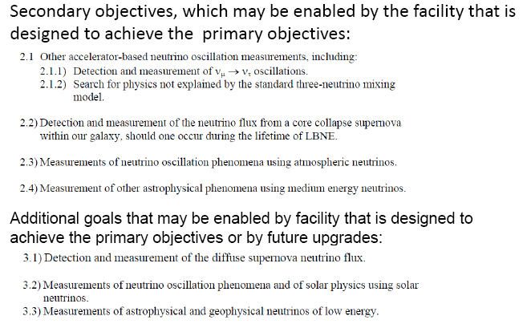
Neutrino oscillations
Proton decay

Slide 34
Long-Baseline Neutrino – Far Detectors
Two technical options for far-detectors at DUSEL site, water Cherenkov detector (WCD) or liquid argon detector(LAr), to achieve equivalent of 200 kt of water.
Reference (not preference) configuration of 1 WCD (100kt) and 1 LAr(20kt).
Alternates
  2 WCD and no Lar
  No WCD and 2 Lar
Planning for choice by spring 2011 in order to proceed with DUSEL final design

Slide 35
Water Cherenkov Far Detector
Preliminary DUSEL design for single cavity for 100 kton
Conceptual design for multiple such cavities
Alternative designs studied somewhat
Includes single cavity with larger span(65m) and depth

Slide 36
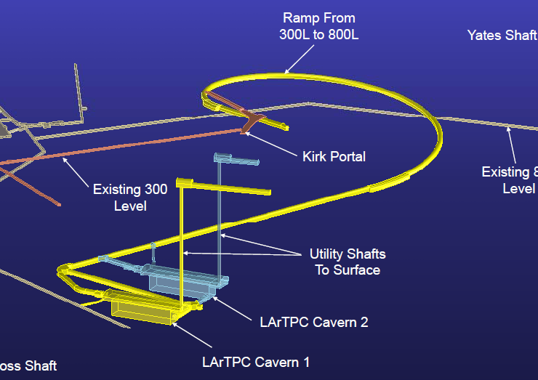
Liquid Argon Detector
20 kton
∼20m x 75m pit
Membrane cryostat
Drive in access

Slide 37
Dark Matter - Goals
Current (or soon to be current) dark matter experiments are ∼ Generation 1 (G1) e.g. LUX
Planning for G2 has started in U.S. (aimed at mid-decade)
DUSEL facility key goal: one or possibly more Generation 3 (G3) (10⁻⁴⁷ or lower for WIMP) dark matter experiments
Possibility to house a G2 experiment (in the Davis Campus by ∼ 2015) is being explored but commitment not yet made – can it be done with negligible impact on DUSEL construction?

Slide 38
Dark Matter – Implementation @4850L
Planning in Generation 3 for multi-tonne experiments
Dark matter experiments can be housed at 4850L eg. in Lab Module #2(20m wide, 24m to crown and 100m long) or Lab Module #1(20m wide, 24m to crown, 50m long)
For example, it appears possible to fit two cryogenic “targets” (LXe and LAr) for dark matter in Lab Module #2, allowing for assembly and shared space
Shielding size is uncertain to ∼ 20% => 20m/24m may be tight.
Plan to work with interested community over next year to advance design of cryogenic dark matter experiments (including potential scintillator shielding) in lab module#2

Slide 39
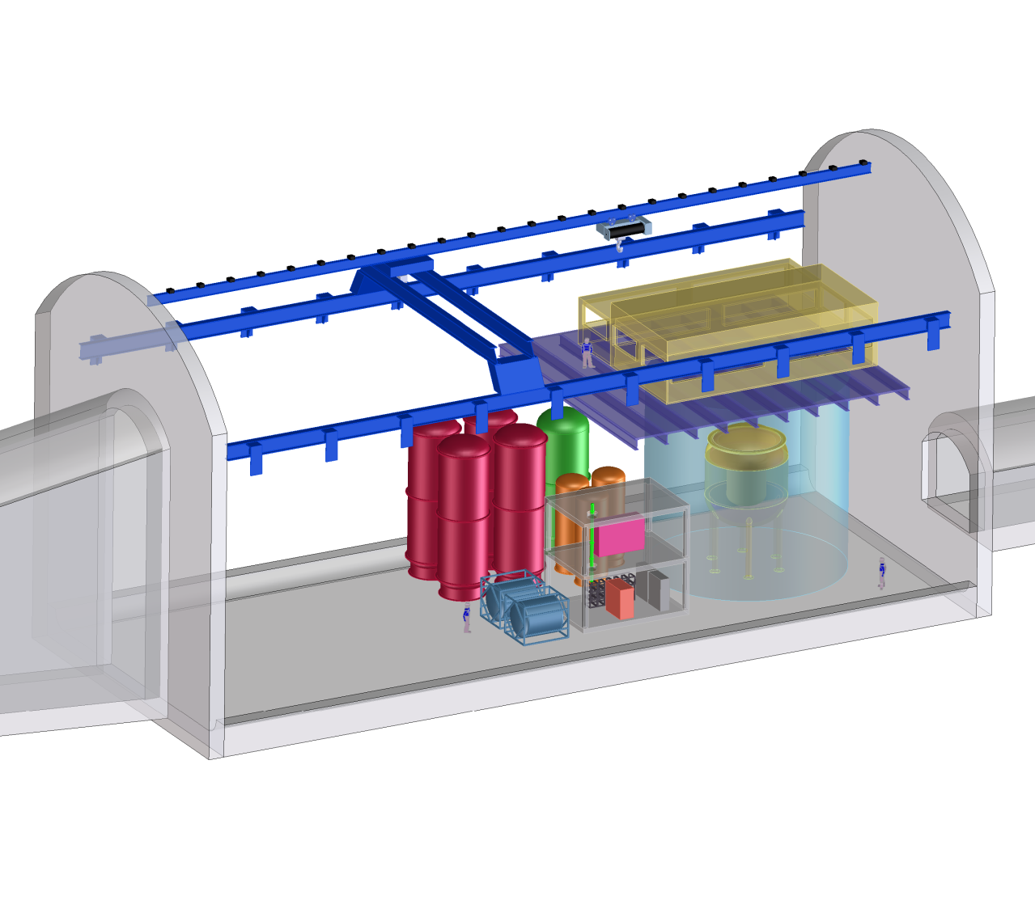
LM1 (MLL)
LZD LXe Dark Matter
R&D Space

Slide 40
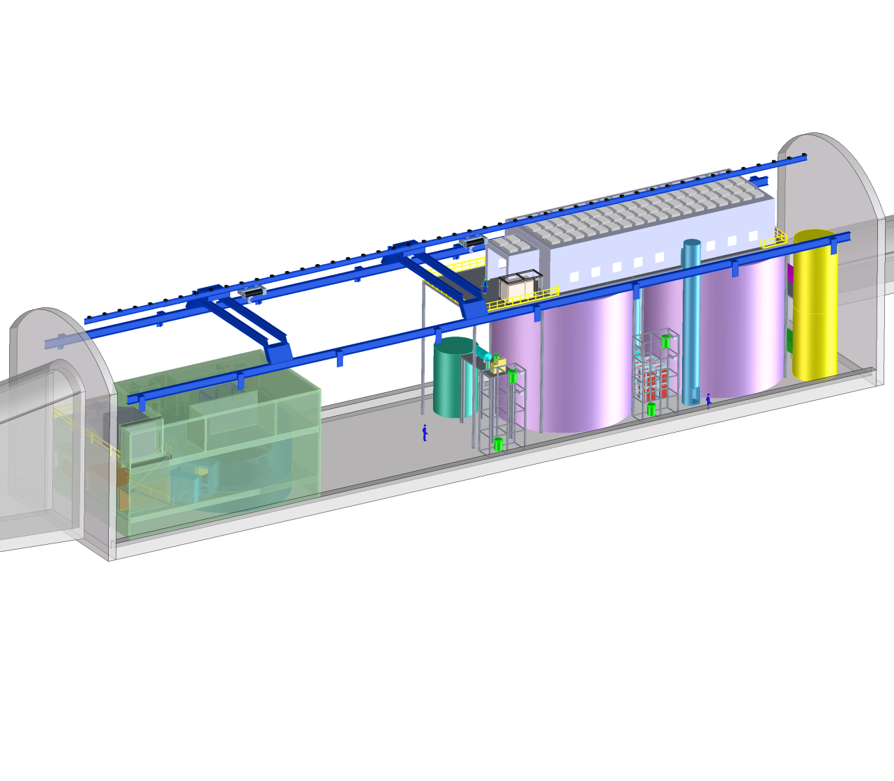
LM2 (MLL)
MAX LAr, LXe Dark Matter
- Layout violates height allowance
FAARM Advanced Low
Background Counting

Slide 41
Dark Matter – Implementation @7400L
Possible at 7400L Lab Module but size limited, smaller module(15m wide, 15m to crown and 75m long) and competition with 0νββ experiment.
In presence of 0νββ experiment, will limit dark matter detector type (Ge detector, CDMS successor, example shown here)
Tight fit

Slide 42
0νββ Experiments - Goals
Tonne scale experiments at DUSEL to push the limits of searching for 0νββ decay => lepton number violation and measurements of neutrino properties
We have interacted almost exclusively with two types of experiments, EXO (Xenon) and 1TGe (a potential successor to the MAJORANA Demonstrator experiment) to establish facility goals.
Believe representative of broader community but welcome input.

Slide 43
0νββ Experiments - Implementation
Both EXO and 1TGe have expressed very strong preference for 7400L.
Only one 0νββ tonne-scale experiment possible at 7400L, cannot fit more than one
Different options for shielding for these experiments (e.g GERDA style or similar)
Not all options fit within 7400L lab module footprint as currently understood
Again plan study with community over next year to refine design of lab module

Slide 44

LMD (DLL)
Cryogenic 0νββ experiments
may not fit in cross-section.
GEODM Ge Dark Matter
1TGe Ge 0νββ, Cu/Pb Option
-Layout is very tight, study sharing operational space

Slide 45


Dakota Ion Accelerators for Nuclear Astrophysics (DIANA)
Required Space 20 × 20 × 50 m³ (W × H × L) at 4850L.
Notes:
4 topics
Process and where we are in this process
Designing the facility to support the science
Timelines, Management and Organization
Stewardship model

Slide 46

Modified LM1 at 4850L for DIANA
Some modifications to generic LM1 lab module would be needed for DIANA – studies underway over next 9 months.

Slide 47
Planning - Funding
DUSEL is a Major Research Equipment and Facilities Construction (MREFC) proposal to the U.S. National Science Foundation (NSF)
Current proposed scope is $875M (FY10), $575M for facility (not including LBNE) and $300M for experiments, including contribution of $125M to LBNE. Remainder of LBNE costs, including for civil construction would come from U.S. Department of Energy and other sources.
Stewardship model for experiments and facility developed by U.S. agencies – see below
International partnership(in experiments) is essential, needs much more development

Slide 48
Planning - Schedule
DUSEL (and LBNE) – big project, many steps
DUSEL Preliminary Design Report and proposal to be submitted by early Spring of 2011
LBNE project on roughly parallel timescale
Reviews and more reviews through Spring of 2011
DUSEL decision by end of 2011
If yes, start Final Design in early 2012
And start construction in early 2014
Facility completed by end decade, full complement of initial experiments a few years later

Slide 49
Summary
Sanford Underground Laboratory at Homestake under active development and expect to deploy first major physics experiments starting in about one year.
Proposal for Deep Underground Science and Engineering Laboratory (DUSEL) well advanced and expect U.S. government decision also in about one year
If fully approved, and in collaboration with partners, could provide facility and experiments for neutrino oscillation measurements and other properties, proton decay searches, dark mater experiments, neutrinoless double beta decay experiments, nuclear astrophysics via underground accelerator, advanced R&D on low background techniques and a variety of experiments in underground biology and engineering and geosciences.

Slide 50

Backup

